Slide 1
The SELECT Statement
Lecturer: Ngo Huy Bien
Software Engineering Department
Faculty of Information Technology
VNUHCM - University of Science
Ho Chi Minh City, Vietnam
nhbien@fit.hcmus.edu.vn

Slide 2

Objectives

Slide 3

Contents

Slide 4

References
Adam Jorgensen et al. (2012). Microsoft SQL Server 2012 Bible. Wiley.

Slide 5
Transact-SQL [1]
SQL was invented by E. F. Codd in 1971.
ANSI SQL 92 standard, SQL-1999, SQL-2003
Transact-SQL, or T-SQL — the dialect of SQL understood by SQL Server.
Reason: including commands for controlling SQL Server properties, or providing the level of logical control within batches required to develop a SQL Server–specific application.
T-SQL, by default, also handles nulls, quotes, and padding differently than the ANSI standard.

Slide 6
SQL and T-SQL Commands
Data Manipulation Language (DML): includes the common SQL SELECT, INSERT, UPDATE, and DELETE commands.
Data Definition Language (DDL): Commands that CREATE, ALTER, or DROP data tables, constraints, indexes, and other database objects.
Data Control Language (DCL): Security commands such as GRANT, REVOKE, and DENY that control how a principal (user or role) can access a securable (object or data.)

Slide 7
T-SQL Query and Batches
A query is a single SQL DML statement, and a batch is a collection of one or more T-SQL statements.
The entire collection is sent to SQL Server from the front-end application as a single unit of code.

Slide 8


Slide 9
SELECT Statement: Syntactical Flow
In its basic form, the SELECT statement tells SQL Server what data to retrieve, including which columns, rows, and tables to pull from, and how to sort the data.
SELECT [DISTINCT][TOP (n)] *, columns, or expressions
[FROM data source(s)]
[JOIN data source
ON condition](may include multiple joins)
[WHERE conditions]
[GROUP BY columns]
[HAVING conditions]
[ORDER BY Columns];

Slide 10
Example
SELECT [id]
,[version_string]
,[version_major]
,[version_minor]
,[version_build]
,[version_revision]
FROM [msdb].[dbo].[msdb_version]

Slide 11
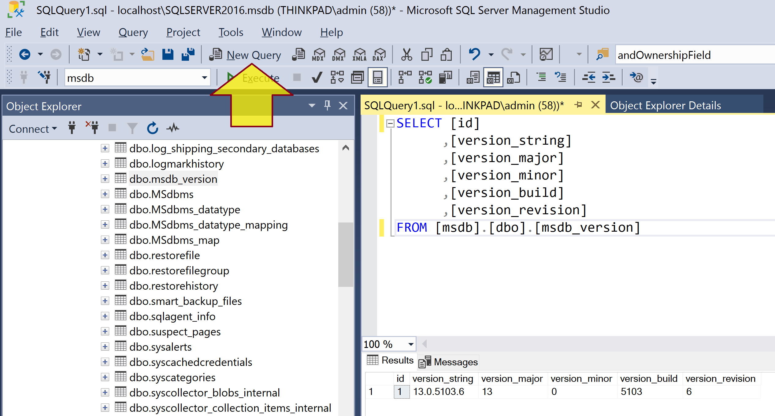
Create and Execute a Query
Query Editor

Slide 12
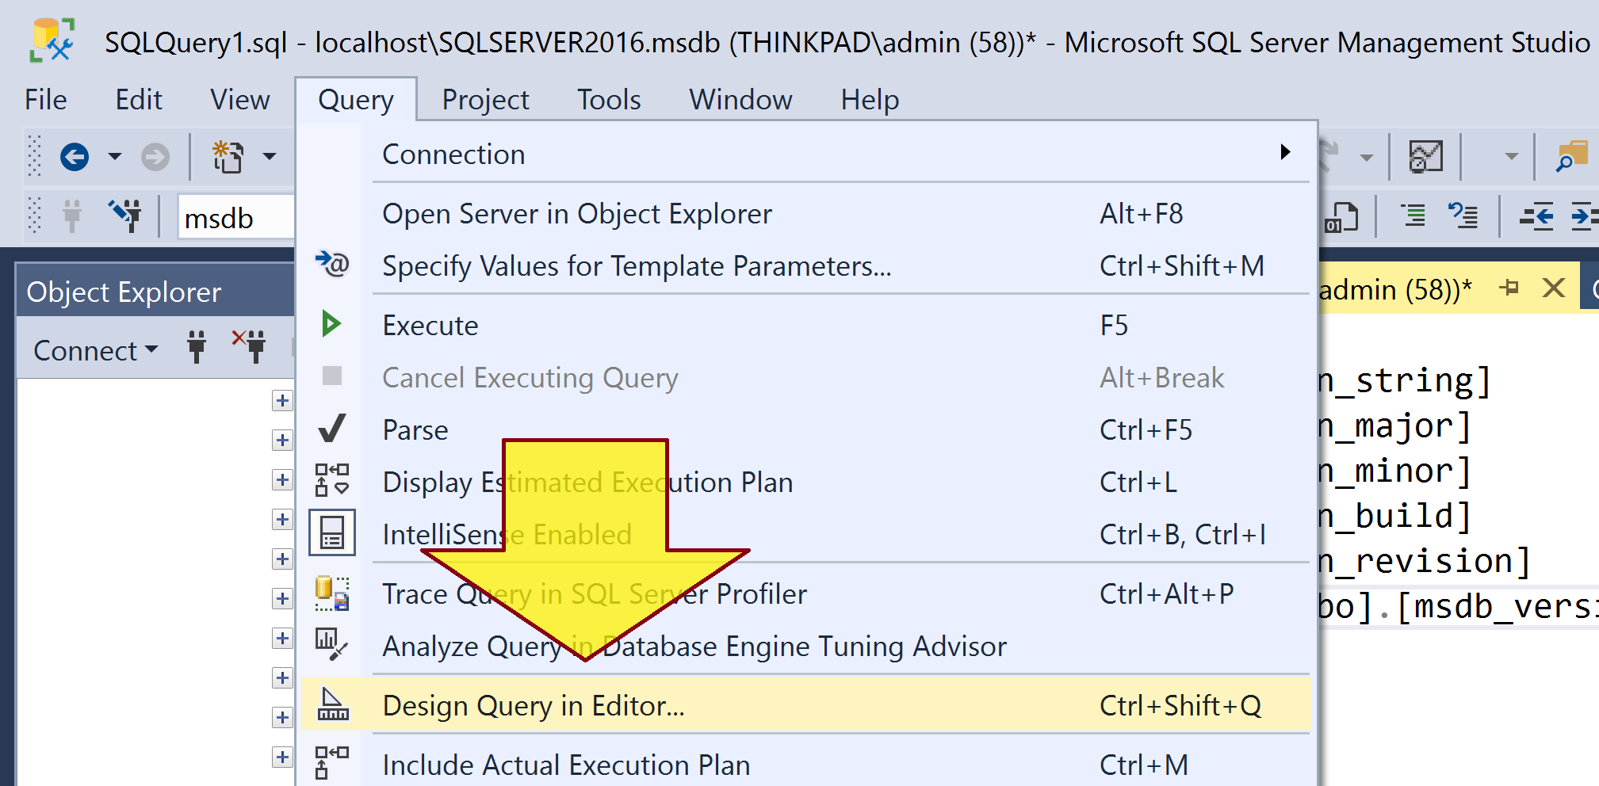
Query Designer
SQL Server Management Studio includes two basic methods to construct and submit queries: Query Designer and Query Editor.
Query Designer offers a graphical method to build a query, whereas Query Editor is an excellent tool for writing SQL code.

Slide 13
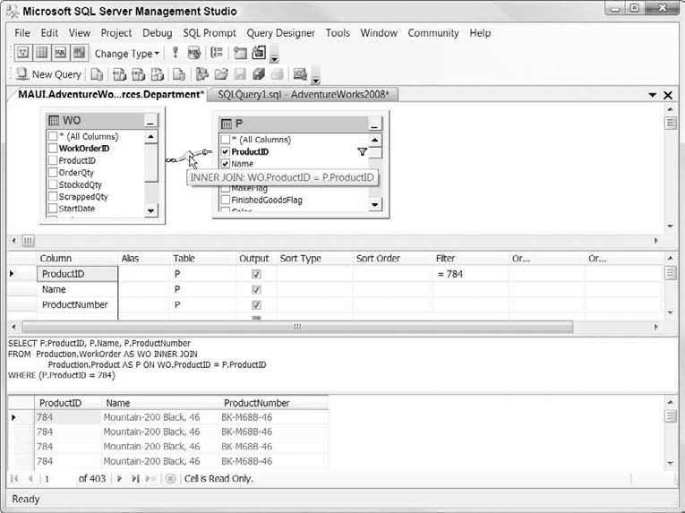
Example of Using Query Designer

Slide 14
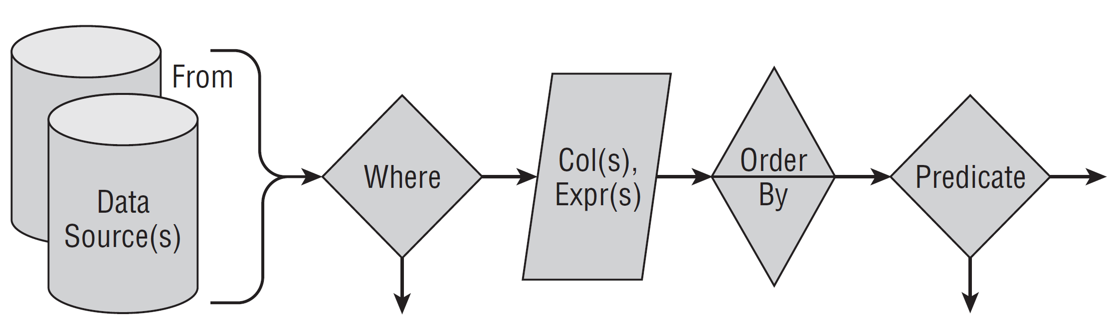
SELECT Statement: Logical Flow
Understanding the flow of SELECT and how to read the query execution plan will help you think through and develop difficult queries.

Slide 15
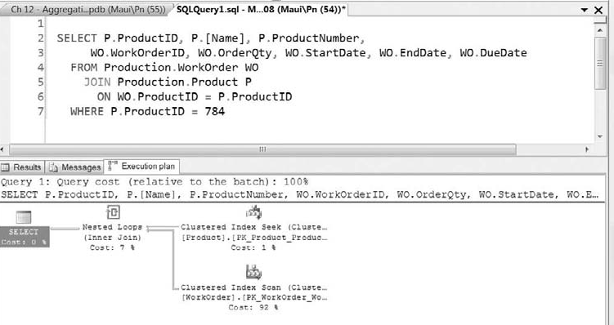
SELECT Statement: Physical Flow
SQL Server will take the SELECT statement and develop an optimized query execution plan, which may not be in the execution order you would guess.
The indexes available to the SQL Server Query Optimizer also affect the query execution plan.

Slide 16
Query Plan Reuse
SQL Server generates a query execution plan the first time the query is executed and then stores that query execution plan in memory.
The next time the same query is executed, SQL Server uses the stored query execution plan instead of generating a new plan.
SQL Server compiles both SQL queries and stored procedures into query execution plans.

Slide 18
View
A view is the saved text of a SQL SELECT statement that may be referenced as a data source within a query, similar to how a sub-query can be used as a data source — no more, no less.
A view can’t be executed by itself; it must be used within a query.
The goal when developing views is two-fold: to enable users to get to the data easily and to protect the data from the users.
By building views that provide the correct data, you are preventing erroneous or inaccurate queries and misinterpretation.

Slide 19
Create and Use Views
CREATE VIEW dbo.vEmployeeList
AS
SELECT P.BusinessEntityID, P.Title, P.LastName,
P.FirstName, E.JobTitle
FROM Person.Person P
INNER JOIN HumanResources.Employee E
ON P.BusinessEntityID = E.BusinessEntityID
SELECT BusinessEntityID, LastName, FirstName, JobTitle
FROM dbo.vEmployeeList

Slide 20
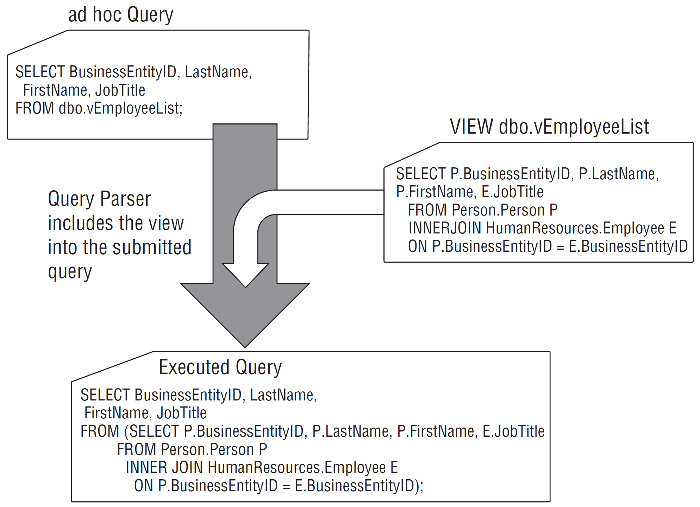
How View Works

Slide 21
Alternatives to Views
The reason to limit views to ad hoc queries and reports isn’t for performance, but for extensibility and control.
Besides views, SQL Server offers several technologies to build an abstraction layer around the data.
Stored procedures are generally my first choice when exposing any data to the outside world.
User-defined functions offer several benefits, and
inline table-valued user-defined functions are very similar to views but with parameters.

Slide 23
Data Types (I)
Character Data Types
VarChar(n)
nVarChar(n)
Numeric Data Types
Bit
Int
Bigint
Decimal
Date/Time Data Types
Datetime
Date

Slide 24
Data Types (II)
Other Data Types
Timestamp
Uniqueidentifier
Binary(n)
Sql_variant
Cursor
Xml
Table

Slide 25
SQL Expressions
You can construct SQL expressions from a nearly limitless list of constants, variables, operators, and functions.
User-defined variables: @MyVariable
Mathematical operators: *, /, % (remainder), +, -
String operator (concatenation): +
Bitwise operators (in order of precedence): not, and &, or |, exclusive or (XOR)
Scalar functions: GetDate(), Radians()
Columns: LastName, PrimaryKeyID
DECLARE @A BIT;
SET @A = 1;
SELECT (~)@A;

Slide 26
Table Variable
DECLARE @listOfIDs Table (id int);
INSERT @listOfIDs(id) VALUES (1), (2), (3), (4), (5);
SELECT id FROM @listOfIDs
WHERE id > 2
SELECT id FROM @listOfIDs
WHERE id <= 2

Slide 27
Integer Division
SELECT 1159/6056
SELECT 1159/CAST(6056 AS DECIMAL (12, 4))
DECLARE @SMales bigint, @SMalesAndFemales bigint, @MalesRatio decimal (12, 4)
SELECT @SMales = 1159
SELECT @SMalesAndFemales = 6056
SELECT @SMales
SELECT @SMalesAndFemales
SELECT @MalesRatio = @SMales / CAST(@SMalesAndFemales AS decimal (12, 4))
SELECT @MalesRatio AS MalesRatio

Slide 29
Add or Remove Linked Servers
EXEC sp_addlinkedserver @server = 'DB1' --or may be server ip address
EXEC sp_addlinkedserver @server = 'DB2' --or may be server ip address
EXEC sp_dropserver 'DB1', 'droplogins';
select name from sys.servers
GO

Slide 30
SELECT From Multiple Servers (I)
DECLARE @#DB1Companies int, @#DB2Companies int
DECLARE @#DB1Users int, @#DB2Users int
SELECT @#DB1Companies = COUNT (*) FROM [DB1DB].[db1.example.com].[dbo].[SNS_Companies]
WHERE ISNULL(IsDeleted, 0) <> 1
SELECT @#DB2Companies = COUNT (*) FROM [DB2DB].[db2.example.com].[dbo].[SNS_Companies]
WHERE ISNULL(IsDeleted, 0) <> 1
SELECT @#DB1Companies + @#DB2Companies AS '# Companies'

Slide 31
SELECT From Multiple Servers (II)
DECLARE @#DB1FullUsers int, @#DB2FullUsers int
SELECT @#DB1FullUsers = COUNT(DISTINCT Membership.UserId)
FROM [DB1DB].[db1.example.com].[dbo].[aspnet_Membership] Membership
INNER JOIN [DB1DB].[db1.example.com].[dbo].[aspnet_Users] Users ON Users.UserId = Membership.UserID
INNER JOIN [DB1DB].[db1.example.com].[dbo].[aspnet_UsersInRoles] UsersInRoles ON UsersInRoles.UserId = Membership.UserID
INNER JOIN [DB1DB].[db1.example.com].[dbo].[aspnet_Roles] Roles ON Roles.RoleId = UsersInRoles.RoleId
AND Roles.RoleName IN ('Full Users', 'Company Administrators',
'Power Users', 'Power Users 2', 'Power Users ', 'Power Users 4', 'Power Users 5',
'Large File Users')

Slide 32
SELECT From Multiple Servers (III)
SELECT @#DB2FullUsers = COUNT(DISTINCT Membership.UserId)
FROM [DB2DB].[db2.example.com].[dbo].[aspnet_Membership] Membership
INNER JOIN [DB2DB].[db2.example.com].[dbo].[aspnet_Users] Users ON Users.UserId = Membership.UserID
INNER JOIN [DB2DB].[db2.example.com].[dbo].[aspnet_UsersInRoles] UsersInRoles ON UsersInRoles.UserId = Membership.UserID
INNER JOIN [DB2DB].[db2.example.com].[dbo].[aspnet_Roles] Roles ON Roles.RoleId = UsersInRoles.RoleId
AND Roles.RoleName IN ('Full Users', 'Company Administrators',
'Power Users', 'Power Users 2', 'Power Users ', 'Power Users 4', 'Power Users 5',
'Large File Users')
SELECT @#DB1FullUsers + @#DB2FullUsers AS '# Full Users'

Slide 33

Thank You & See You Again

